Slide 1

Bike Share Toronto 2018 Insights
Mohit Rathod

Slide 2
Today’s Agenda
Discussion on three dashboards
Yearly Overview
User Behaviour
Station Popularity

Slide 3
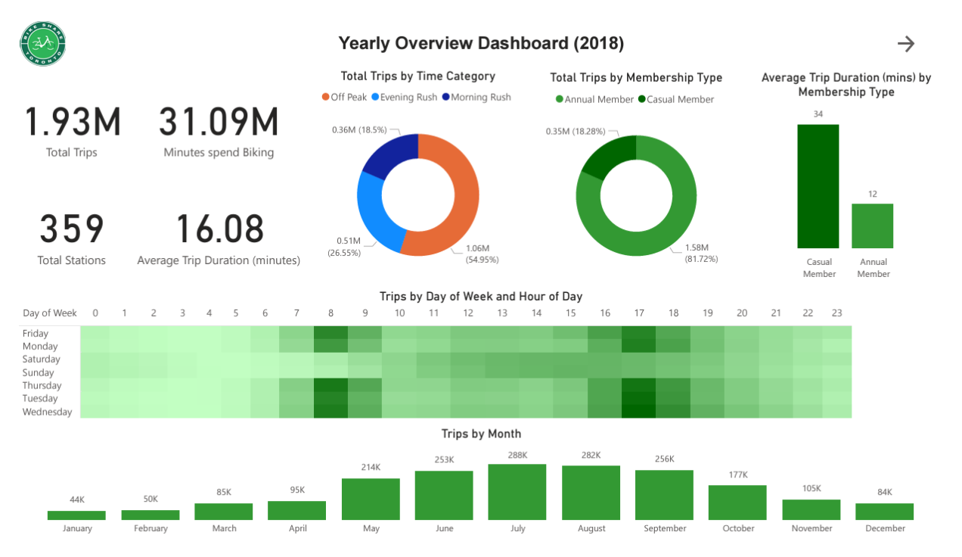

Slide 4
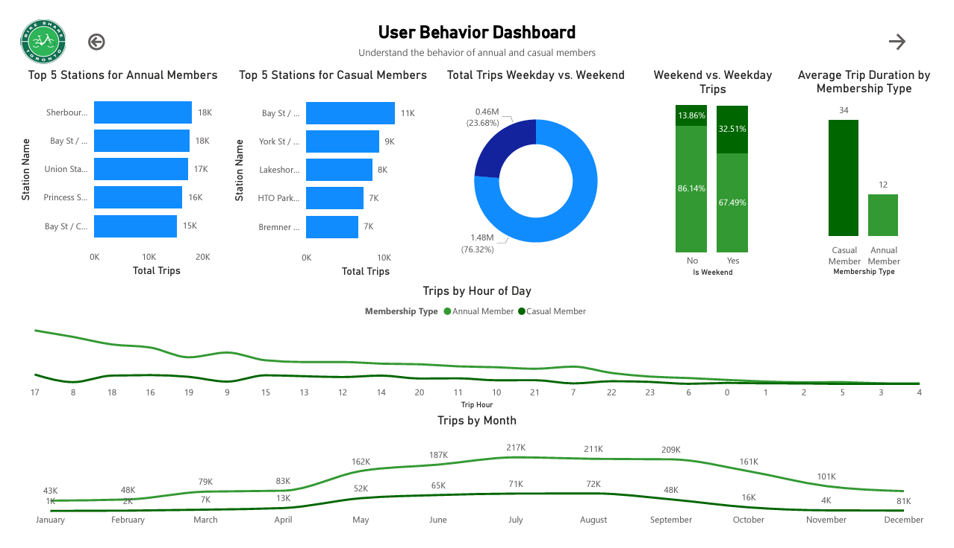

Slide 5
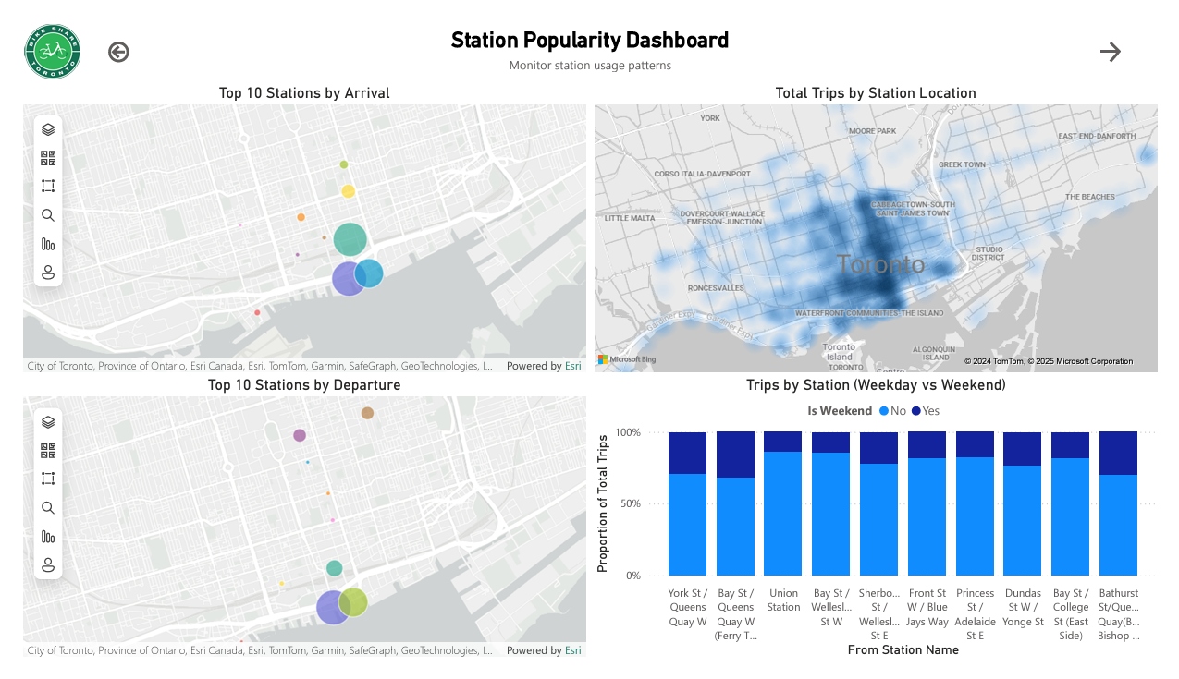

Slide 6
Total Activity Highlights:
1.93 million total trips were recorded in 2018, amounting to 31.09 million minutes spent biking.
The system had 359 active stations, with an overall average trip duration of 16.08 minutes.

Slide 7
Membership Composition
Annual members accounted for the majority of trips, contributing 81.72%
Casual members made up the remaining 18.28%, with significantly longer average trip durations (34 minutes compared to 12 minutes for annual members).

Slide 8
Weekend vs. Weekday Usage
Weekday trips are dominated by annual members at 86.14%
Casual members contributed to 32.51% of weekend trips.

Slide 9
Trips by Time of Day
Peak usage observed during morning rush hours (7–9 AM) and evening rush hours (4–7 PM).
Evening rush hours had the highest concentration of trips.

Slide 10
Seasonality
Summer months (June: 253K, July: 288K, August: 282K) witnessed the highest ridership.
Winter months (January: 44K, February: 50K) saw significantly lower trips.

Slide 11
Station Popularity
Most popular stations for Annual Members include Sherbourne St / Wellesley St E, Bay St / Queens Quay W, and Union Station.
Casual users favored stations near recreational areas like York St / Queens Quay W and HTO Park.

Slide 12
Trip Duration and Time Categories
Duration Patterns: The majority of trips fell in the 5-15 minute range (over 1 million trips). A smaller portion of trips were under 1 minute, highlighting efficient short-distance usage.
Time Categories: Off-Peak: Largest share of trips (54.95%). Morning Rush: 26.55%. Evening Rush: 18.5%.

Slide 13
Weekend vs. Weekday Insights
Weekday Trips: Dominated by commuters, reflecting heavy reliance on BikeShare for work-related travel.
Weekend Trips: Higher proportion of recreational use, with casual members showing stronger activity.

Slide 14
Arrival and Departure Trends
Stations near major transit hubs (like Union Station) experienced the highest traffic for both arrivals and departures, showcasing their importance for daily commuters.
Stations near recreational areas were also highly utilized, particularly by casual members during weekends and leisure trips.

Slide 15

Thank You for Your Time and Attention!
I hope you found these insights into Toronto’s BikeShare program both engaging and informative.
If you have any questions, suggestions, or would like to discuss this further, feel free to connect with me.

